Slide 1
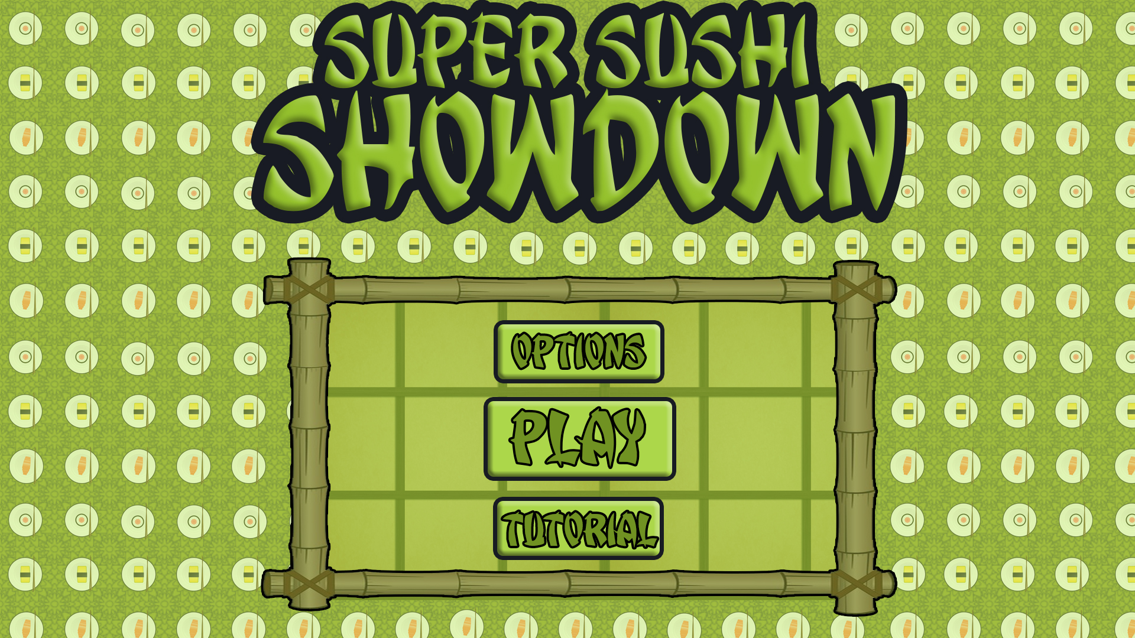
Level 4/5 – Group 5
Bandi Namco Third Pitch
Henry Crofts, Ashley Long, Samuel McMillan and Dawid Hojka

Slide 2
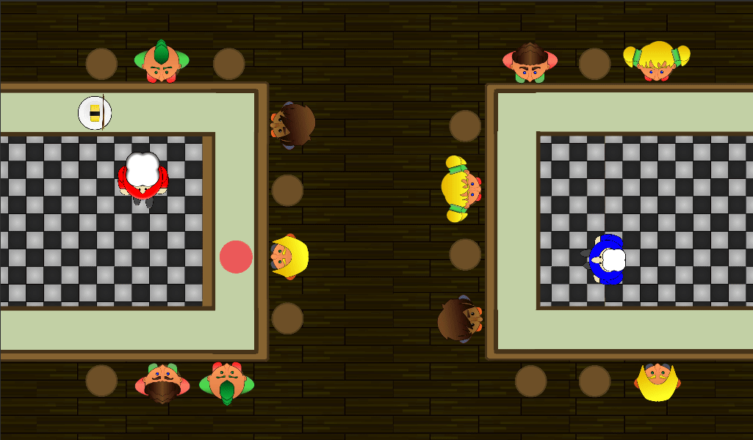
Latest version

Slide 3

node changes
Did you feel like the game was too slow?
“The speed the sushi moves at is quite slow”
Increase the speed of sushi
“The sushi was hard to tap, kept missing”
Increased the size of sushi colliders
Adjusted the raycast layer

Slide 4
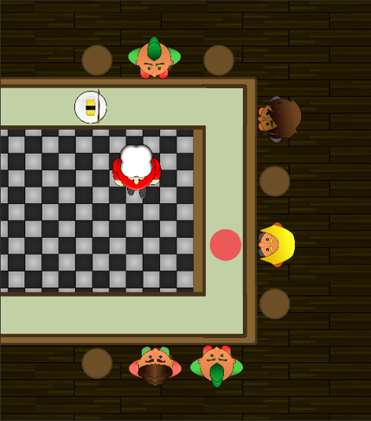
Negative feedback loop
Did the game become more challenging?
How are you keeping the game fair?
Variable speed change

Slide 5




Score confusion
Did you understand who was winning and losing throughout the whole game?
Who is winning?
Use customers to display score

Slide 6




Added animated feedback
Did you find the game challenging and why?
“I’m not really sure if I’m hitting the node correctly”
Added animated chefs pop ups

Slide 7

Playtesting video

Slide 8
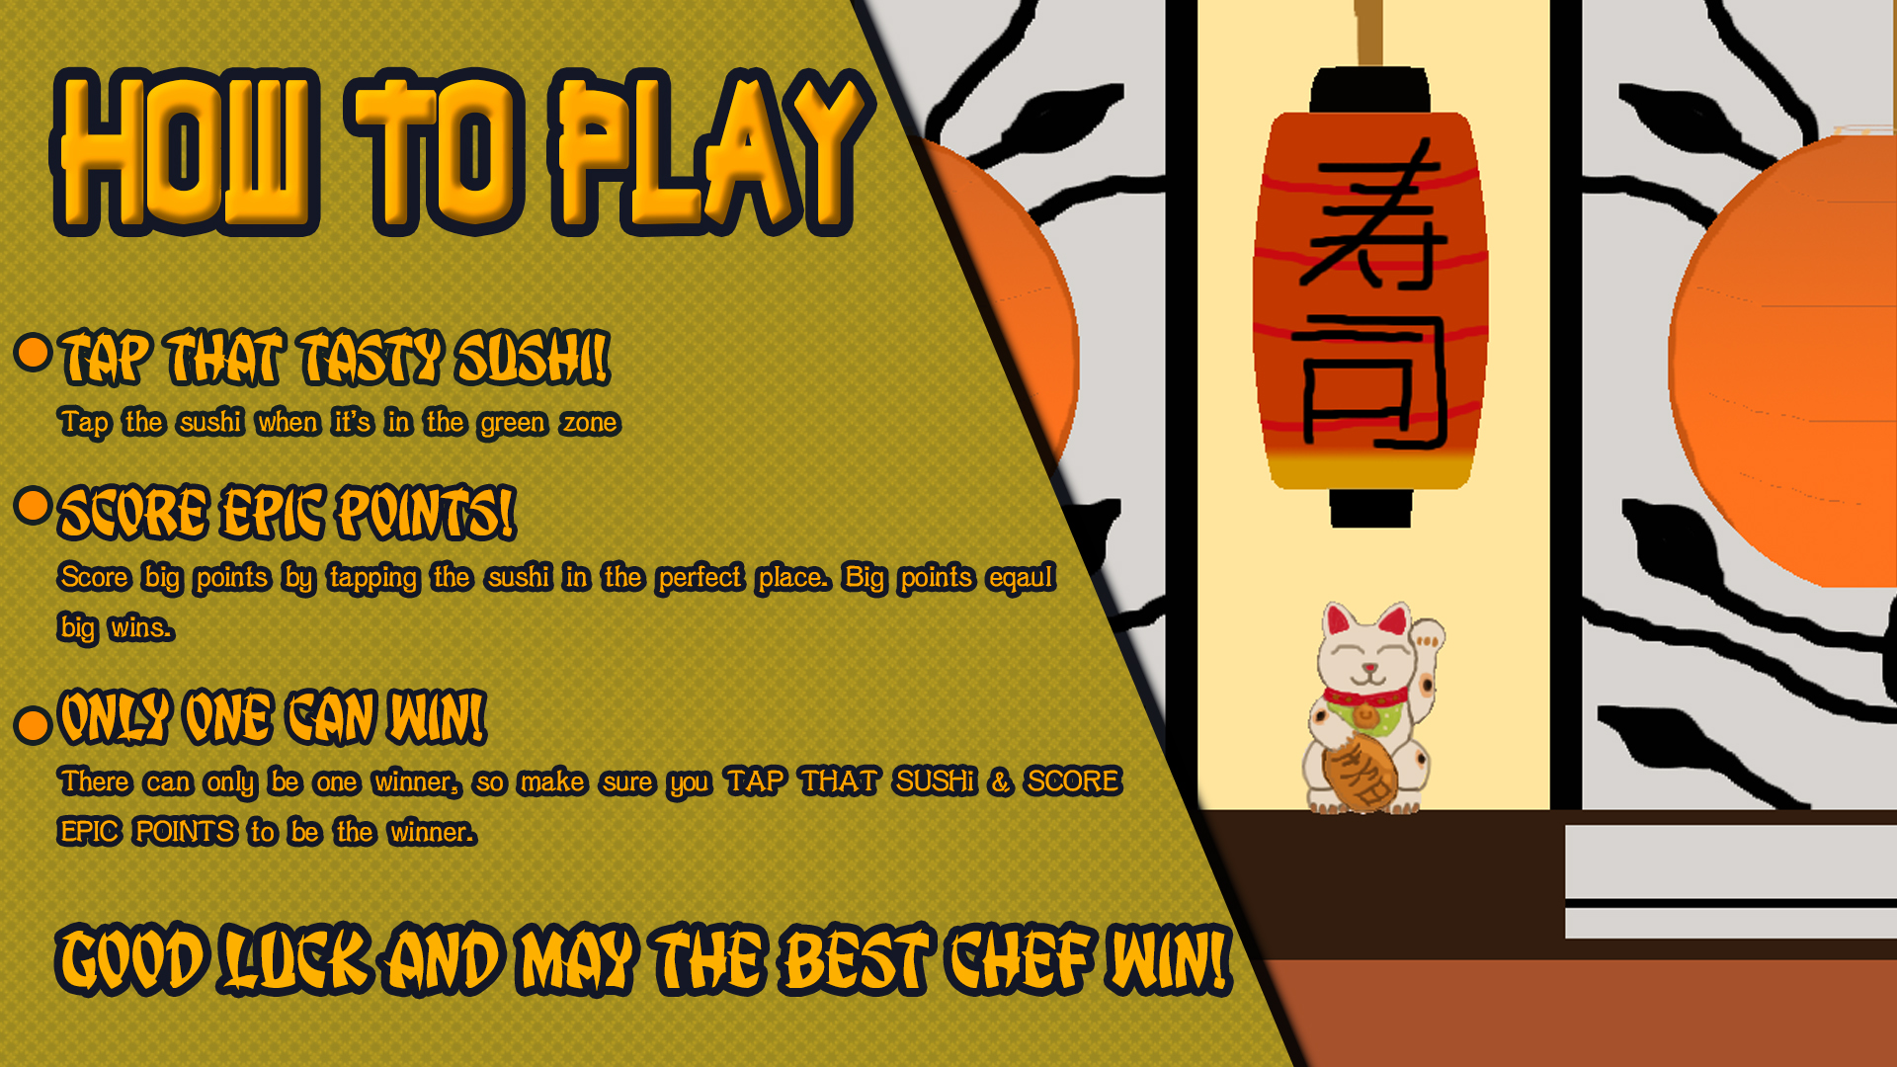
Upcoming changes / polish
Fix bugs
First player disadvantage
Speed does not always change
Update chef movement
Fix customer movement
Update Art
Sushi bars new colours
Up in new chef designs
Update information screen

Slide 9
Questions?

